Slide 1
LEONARDO DA VINCI
History of Western Art
BFA-II (Visual Arts)
Course Incharge: Ms. Farah Khan
Institute of Design & Visual Arts (LCWU)

Slide 2
Leonardo Da Vinci
“Many men and women are born with various remarkable qualities and talents, but occasionally a single person is endowed by heaven with beauty, grace and talent in such abundance that he leaves others far behind, all his actions seem inspired and indeed everything he does clearly comes from God rather than from human art”
Giorgio Vasari (Art Historian)
“Leonardo has often been described as a prime example of the Renaissance Man, a man of “unquenchable curiosity” and “feverishly inventive imagination”.

Slide 3
Leonardo Da Vinci (1452-1519)
A multi-talented artist, far ahead from his own time. He was a painter, sculptor, architect, musician, scientist, mathematician, engineer, inventor, anatomist, geologist, cartographer, botanist and writer.
He was the most creative genius who ever lived, but his creativity was also his undoing: for the enormous range of his interests and the mercurial quality of his mind meant that he brought few projects to completion.
He was born in the small Tuscan town of Vinci and was a gifted child, exceptionally good at mathematics and music, but showing even more talent for drawing.
He father’s friend, the Florentine artist Andrea del Verrocchio, agreed to take him on as a pupil. In Verrocchio’s renowned workshop Leonardo received a multifaceted training that included painting and sculpture as well as the technical-mechanical arts.
When Leonardo was about 18, Verrocchio was commissioned to paint an altarpiece of The Baptism of Christ for a church near Florence. According to Vasari, Leonardo painted one of the angels so well that Verrocchio decided to give up painting and stick to Sculpture.
In 1481 Leonardo received his first major commission- an altarpiece of The Adoration of the Magi for the monastery of San Donato a Scopeto but he left the painting unfinished because in 1481 or 1482 he moved from Florence to Milan at the invitation of the ruler of the city.

Slide 4
Leonardo Da Vinci (1452-1519)
Being in Milan, initially he was given the task of designing entertainments for the court and then he was given the two major commissions of his artistic career. The first was for a huge Equestrian statue and the second for a wall painting of The Last Supper in the refectory of the monastery of Santa Maria delle Grazie. He did experimentation with technique while using pigments with oil in the execution of The Last Supper but the paint peeled off the wall during his lifetime, leaving it the noblest and saddest ruin in the history of art.
In 1499 Leonardo left Milan and embarked on the most unsettled period of his life. Florence was to be the main centre of his activity for the next six years. However, he spent much of 1502 on the move as military engineer to Cesare Borgia.
Some of Leonardo’s military designs have much older precedents, such as his chariot armed with scythes on the wheels, which was a device mentioned in accounts of ancient warfare. Other ideas, however, are remarkable for their audacious inventiveness, and illustrate his ability to look into the future. For example, Leonardo conceived a shrapnel bomb, which was an idea not put into practice until the 18th century.
As far as is known, none of Leonardo’s amazing war machines ever got off the drawing board. One of the main reasons for this was that his designs, for all their ingenuity, were often highly impractical. It was his attempts to design a flying machine that Leonardo suffered most cruelly from the want of an efficient power source. He studied birds and bats and he had the understanding of aerodynamics that was far ahead of his time.

Slide 5
Leonardo Da Vinci (1452-1519)
According to art historian Helen Gardner, the scope and depth of his interests were without precedent and “his mind and personality seem to us superhuman, the man himself mysterious and remote”.
His Last Supper (1495–98) and Mona Lisa (c. 1503–19) are among the most widely popular and influential paintings of the Renaissance. His notebooks reveal a spirit of scientific inquiry and a mechanical inventiveness that were centuries ahead of their time.
In the Florence years between 1500 and 1506, Leonardo began three great works that confirmed and heightened his fame: The Virgin and Child with Saint Anne (c. 1503–19), Mona Lisa (c. 1503–19), and Battle of Anghiari (unfinished; begun 1503). Even before it was completed, The Virgin and Child with Saint Anne won the critical acclaim of the Florentines; the monumental three-dimensional quality of the group and the calculated effects of dynamism and tension in the composition made it a model that inspired Classicists and Mannerists in equal measure.
An artist by disposition and endowment, “he considered his eyes to be his main avenue to knowledge; to Leonardo, sight was man’s highest sense because it alone conveyed the facts of experience immediately, correctly, and with certainty”.

Slide 6
Quotes by Leonardo Da Vinci
Simplicity is the ultimate sophistication.
Art is never finished, only abandoned.
When once you have tasted flight, you will forever walk the earth with your eyes turned skyward, for there you have been, and there you will always long to return.
Learning never exhausts the mind.
The human foot is a masterpiece of engineering and a work of art.
Painting is poetry that is seen rather than felt, and poetry is painting that is felt rather than seen.
Water is the driving force of all nature.
Where the spirit does not work with the hand, there is no art.
The noblest pleasure is the joy of understanding.

Slide 7
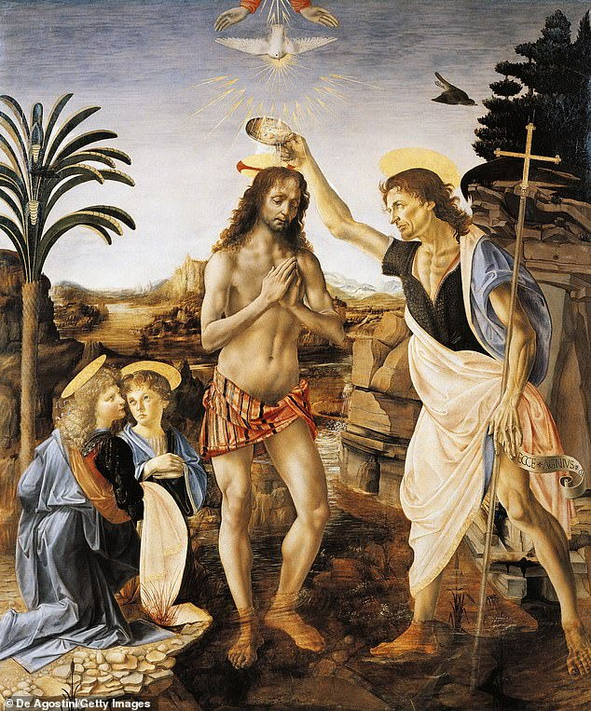
The Baptism of Christ (1470-75)

Slide 8
Monalisa (1474-78) from Florence Italy

Slide 9
Adoration of the Magi (1481-82)

Slide 10
Preliminary sketch for Adoration of the Magi (1481-82)

Slide 11
St-Jerome in the Desert (1482)

Slide 12
Virgin of the Rock (1483-86)

Slide 13
Copy of the Virgin of the Rock (1483-86)

Slide 14
Virgin of the Rock (1483-86)

Slide 15
Study for the Virgin of the Rock (1483-86)

Slide 16
Lady with an Ermine (1483-86)

Slide 17
Vitruvian Man (1490) from Milan, Italy

Slide 18
The Last Supper (1495-98) from Milan, Italy

Slide 19
The Last Supper (copy made in 1498)

Slide 20
Monalisa (1503-1519) from Florence Italy

Slide 21
Virgin and Child with St. Anne (1508)

Slide 22
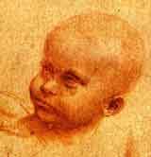
Preliminary drawings

Slide 23
The Virgin and Child with St. Anne and St. John (1508)

Slide 24
Cats, lions and dragons (1517-18)

Slide 25
Vitruvian Man (c.1490/1515-16) from Milan, Italy

Slide 26
St- John the Baptist (1513-16)

Slide 27
Battle of Anghiari by Rubens followed by the sketches of Leonardo

Slide 28
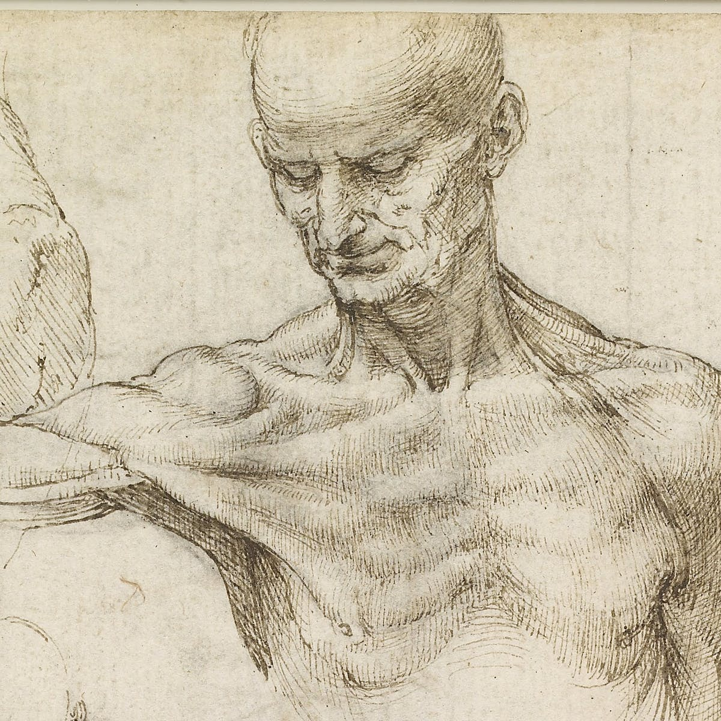
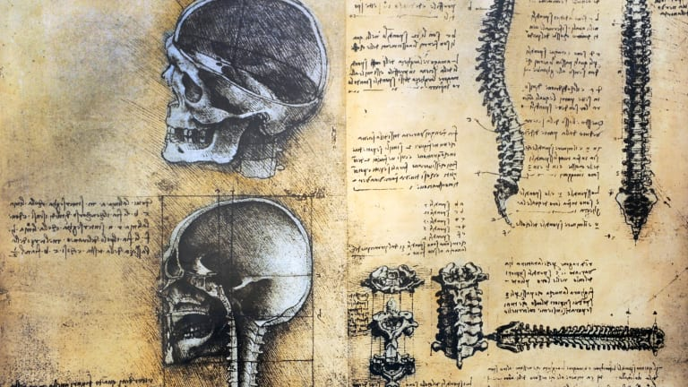
Leonardo’s Anatomical Studies

Slide 29
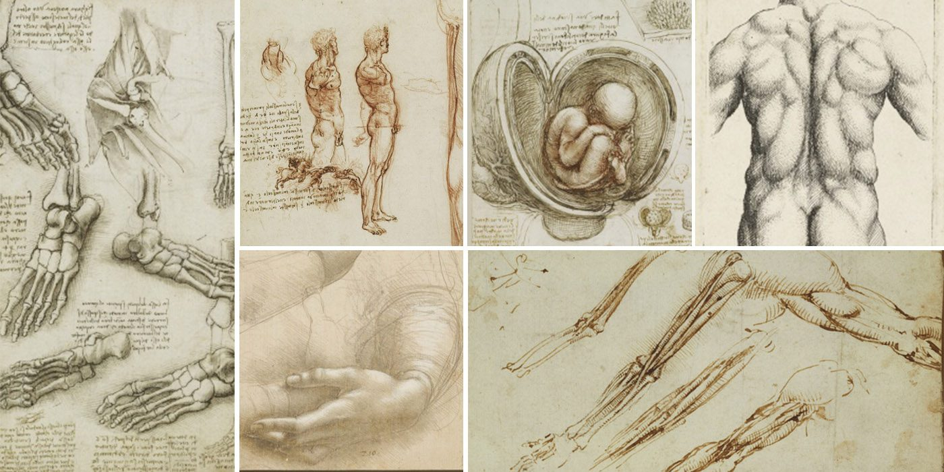
Leonardo’s Anatomical Studies

Slide 30
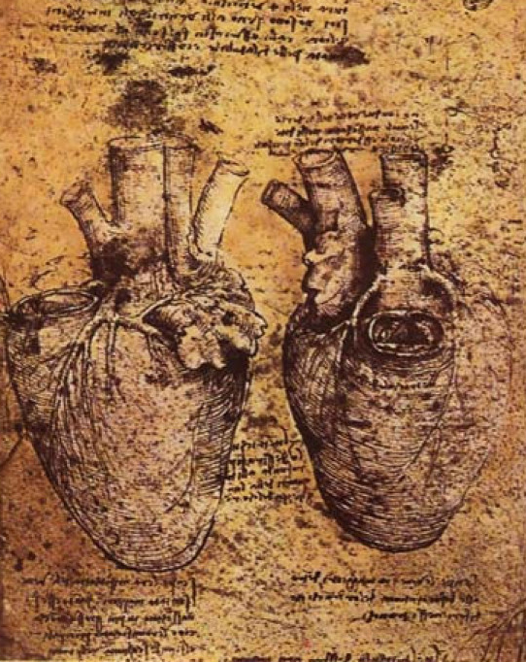
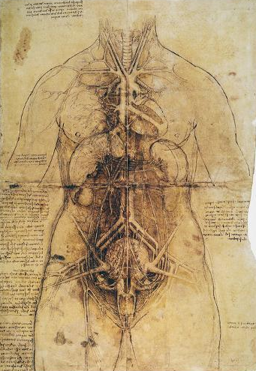
Leonardo’s Anatomical Studies

Slide 31
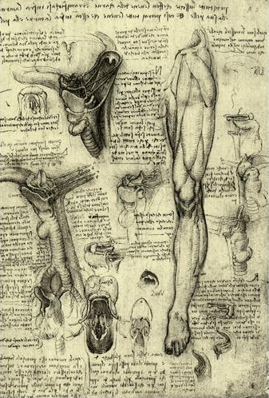
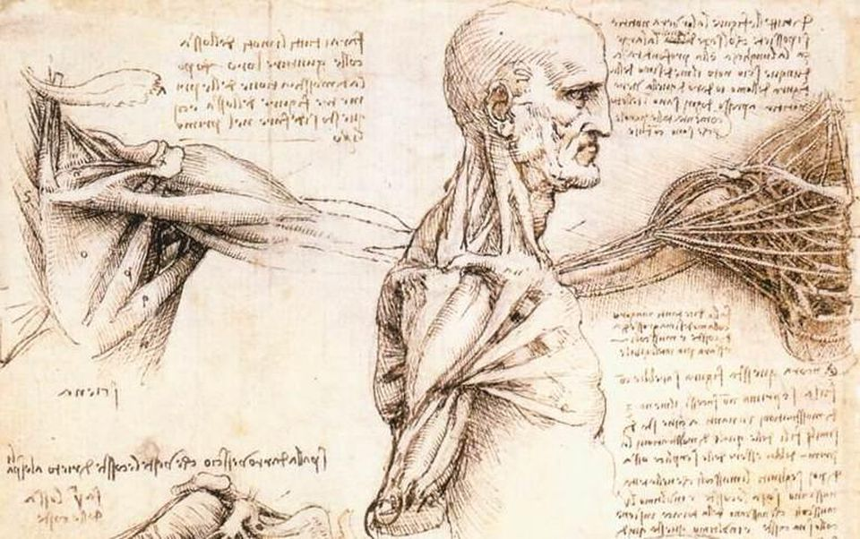
Leonardo’s Anatomical Studies

Slide 32
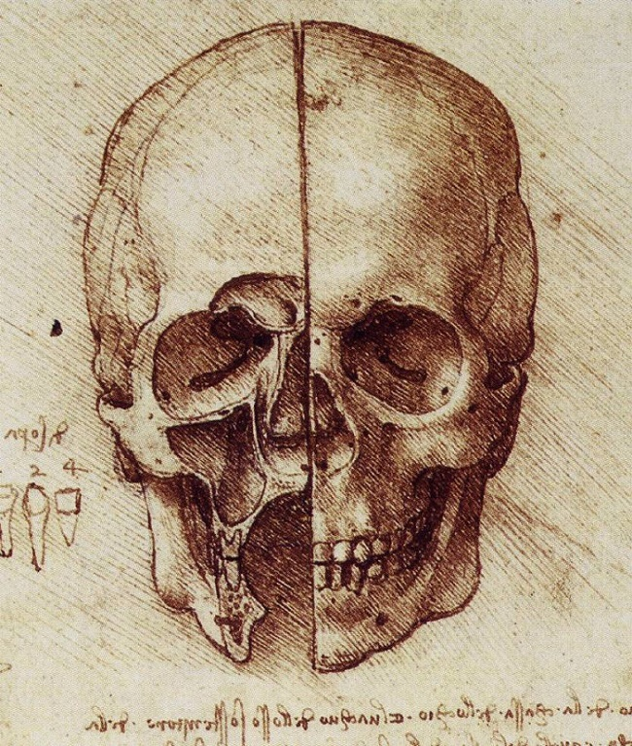
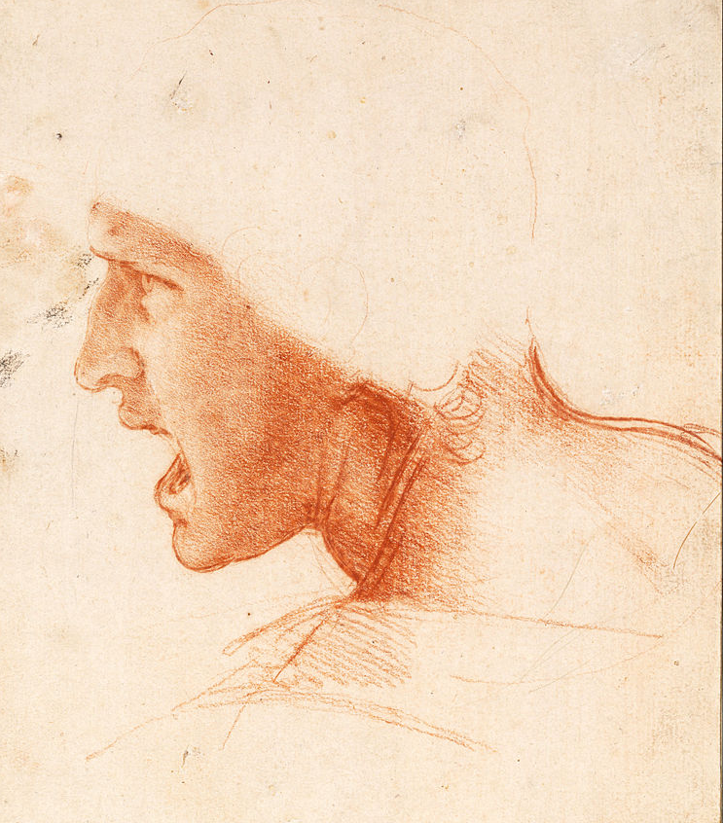
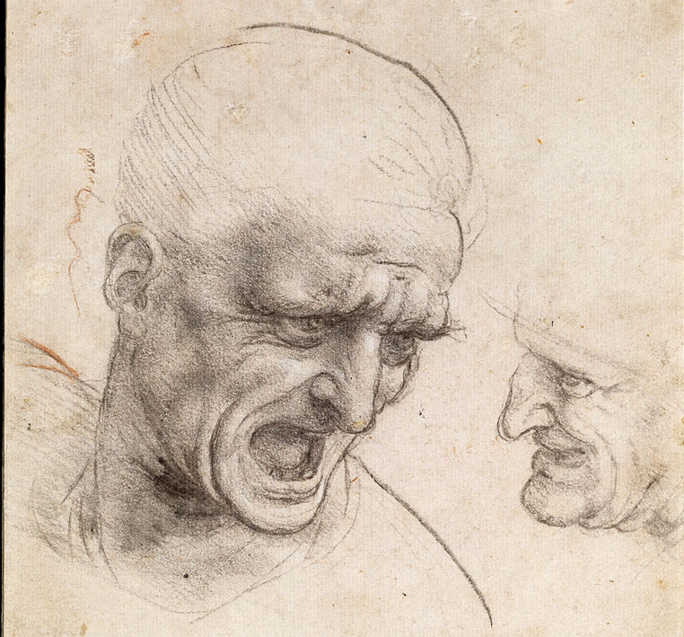
Leonardo’s Anatomical Studies

Slide 33
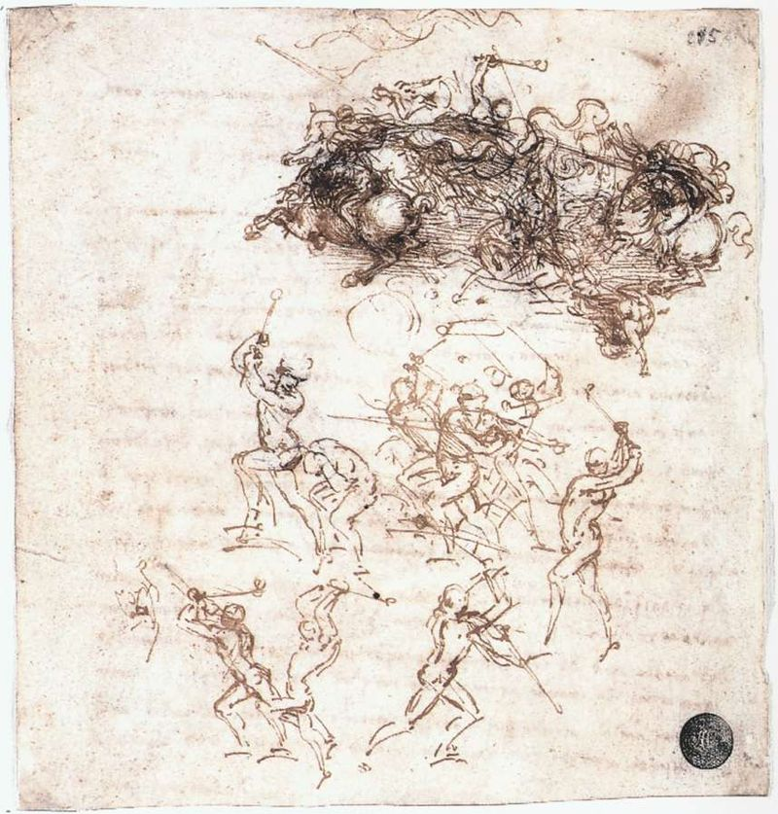
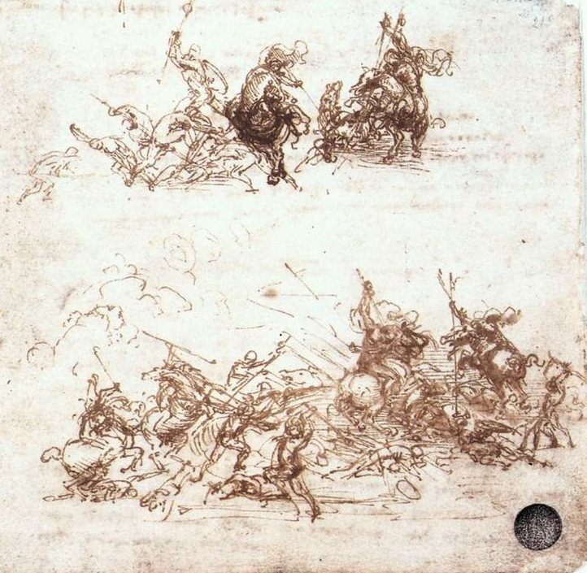
Leonardo’s Anatomical Studies

Slide 34
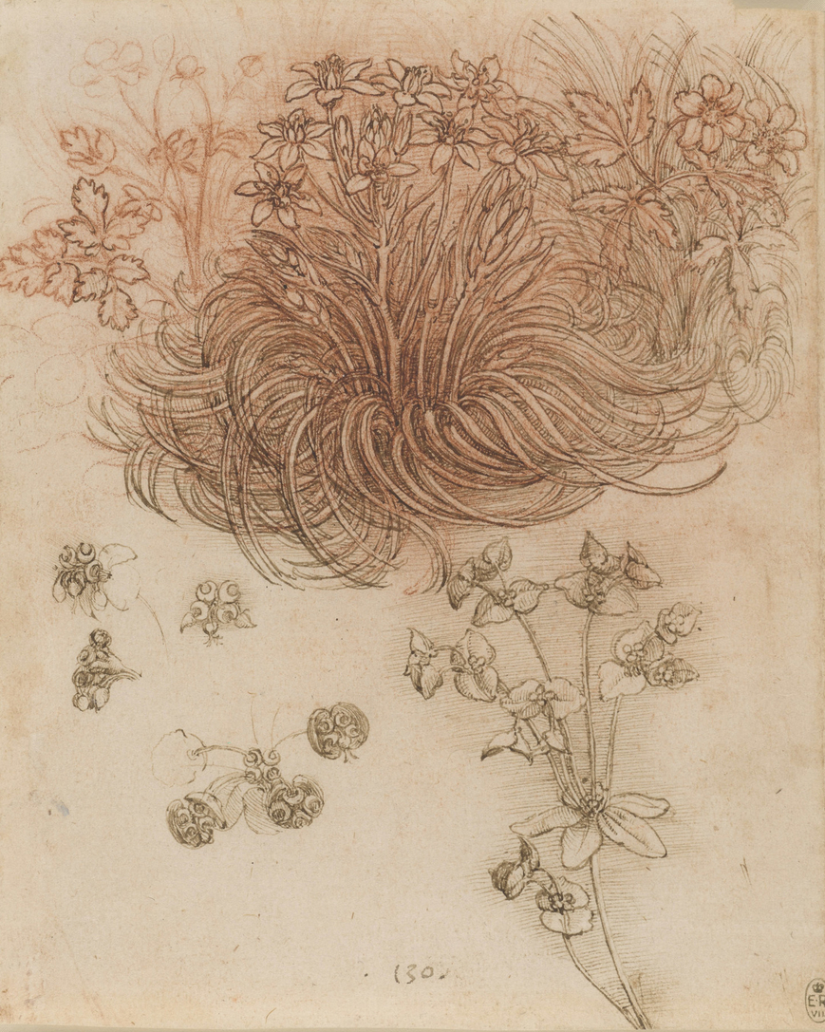
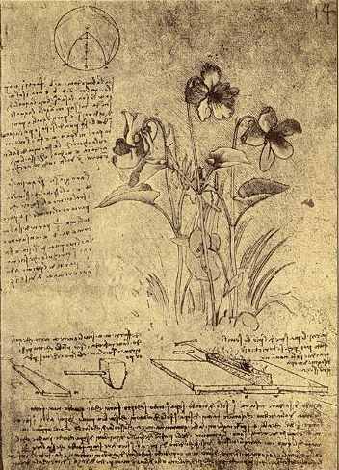
Leonardo’s Botanical Studies

Slide 35
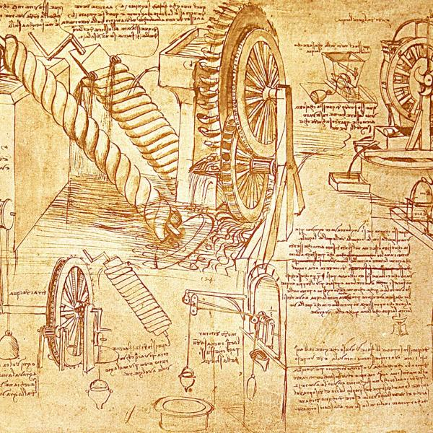
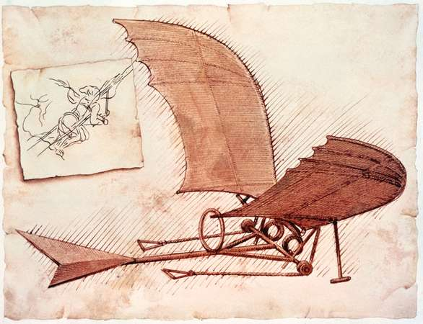
Leonardo’s scientific studies

Slide 36
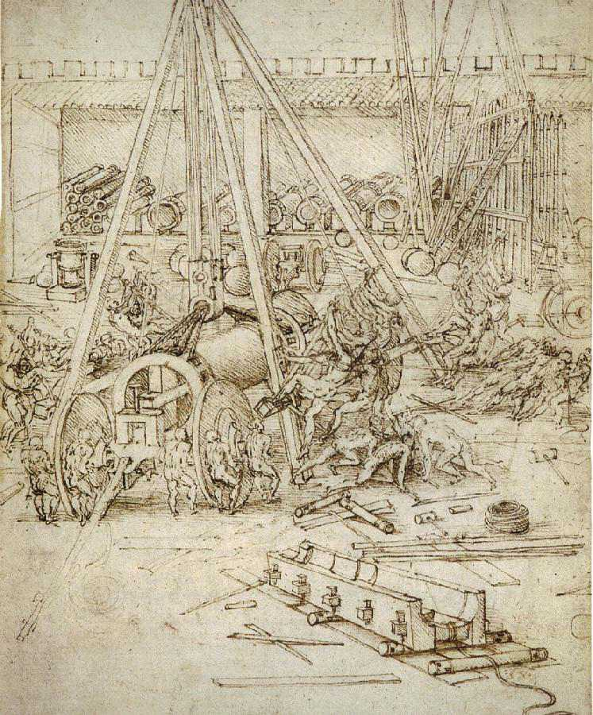
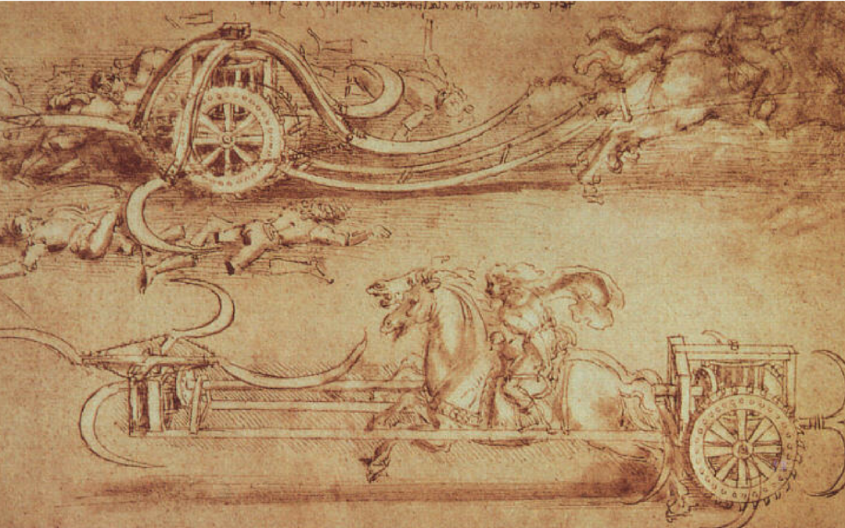
Leonardo’s scientific studies

Slide 37
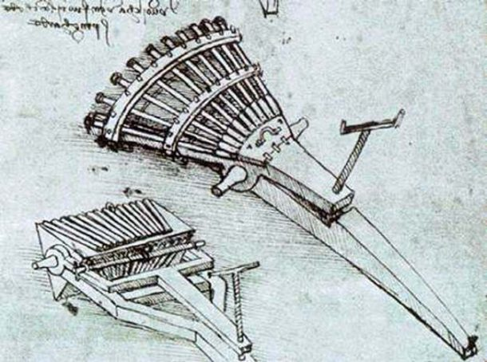
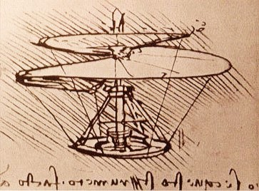
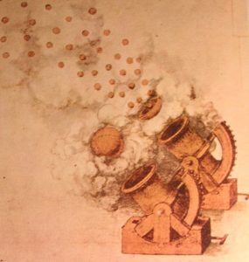
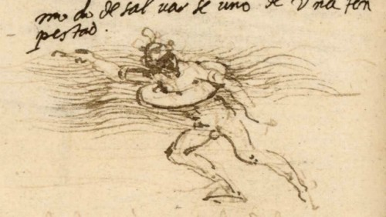
Leonardo’s scientific studies

Slide 38
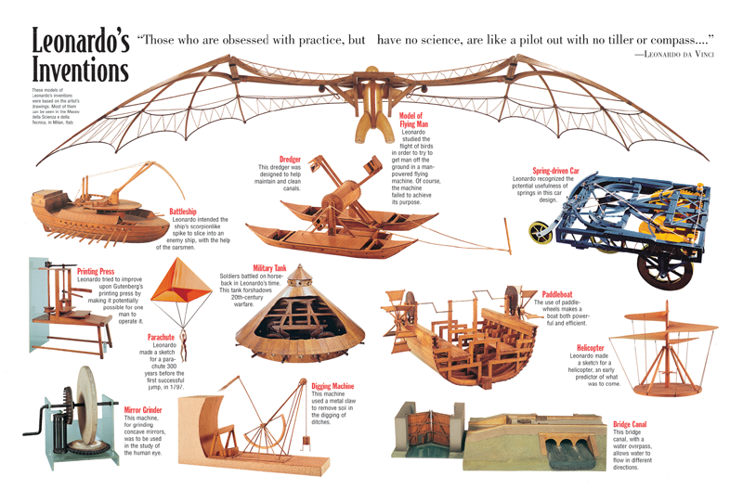
Leonardo’s scientific studies

